Slide 1

DESIGN AND OPTIMIZATION FINAL PROJECT PV Power Matching
Design and Optimization – VÉL113F
Leander Merbecks
21st November, 2024

Slide 2
Motivation
Power
Demand
Power
Supply
Time
Time
Notes:
Supply and demand for PV do not match
Matching can reduce „losses“ due to selling electricity that may be needed later in the day
Ideal case: Power matches completely -> autarc

Slide 3
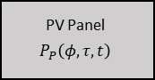
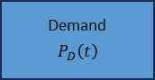
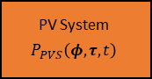
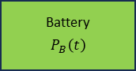
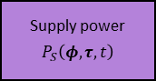
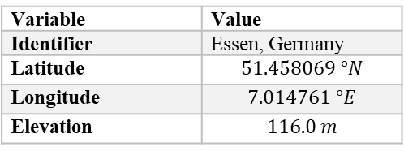
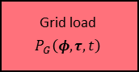
Model Overview
System model
Power supply model
PV System Model
PV Panel
$$P_{P}\left(φ,τ,t\right)$$
Demand
$$P_{D}\left(t\right)$$
PV System
$$P_{PVS}\left(φ,τ,t\right)$$
Battery
$$P_{B}\left(t\right)$$
Variable | Value
Identifier | Essen, Germany
Latitude | $$51.458069 °N$$
Longitude | $$7.014761 °E$$
Elevation | $$116.0 m$$
Supply power
$$P_{S}\left(φ,τ,t\right)$$
Grid load
$$P_{G}\left(φ,τ,t\right)$$
Notes:
Three subsystems
Six components
Description of core components next

Slide 4
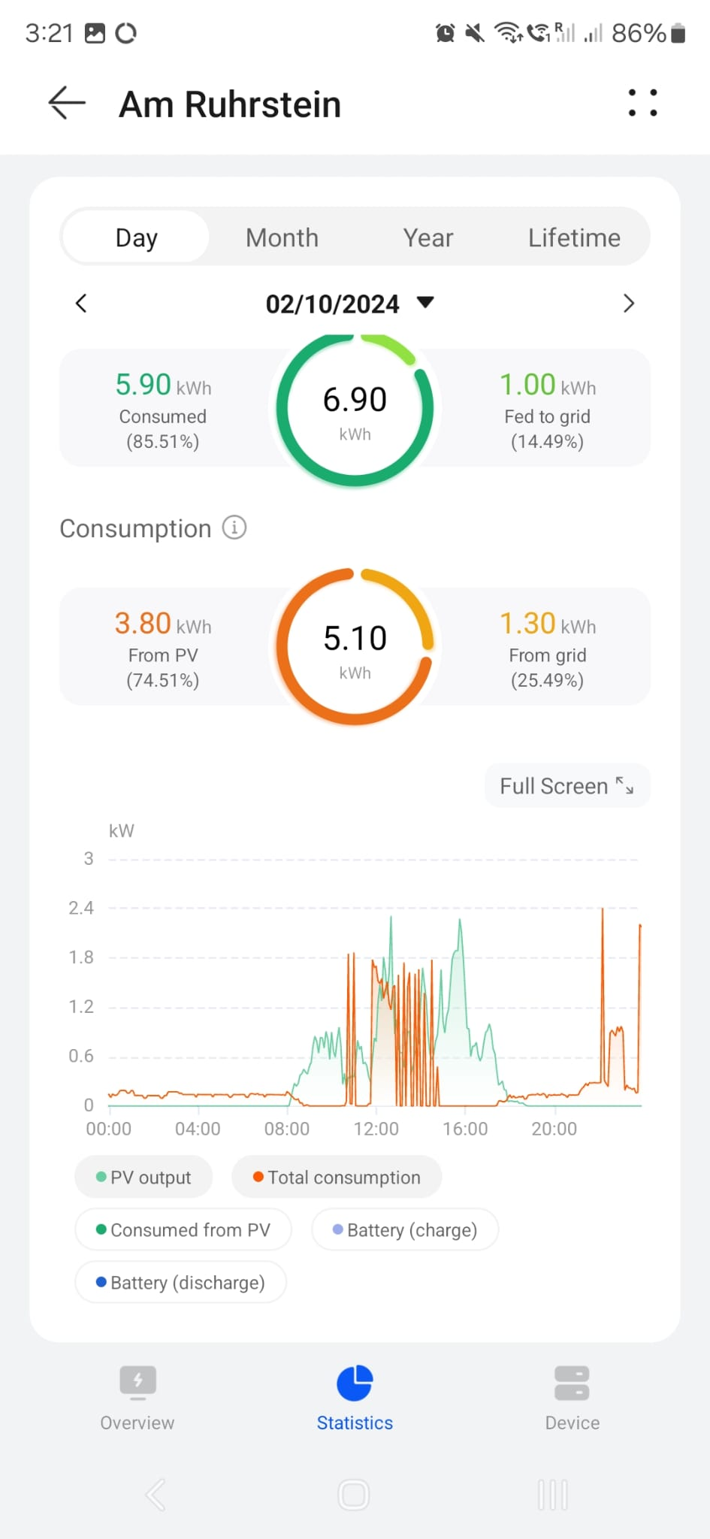
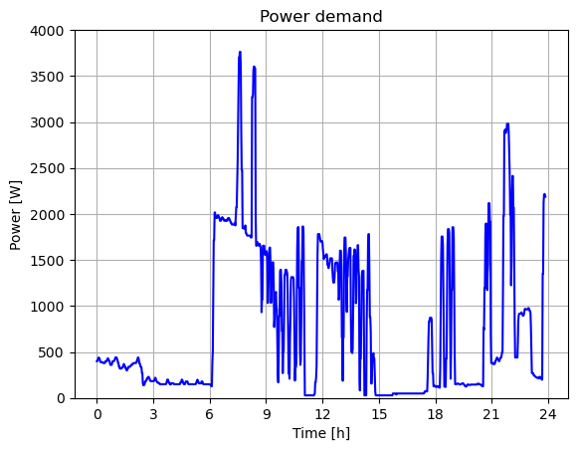
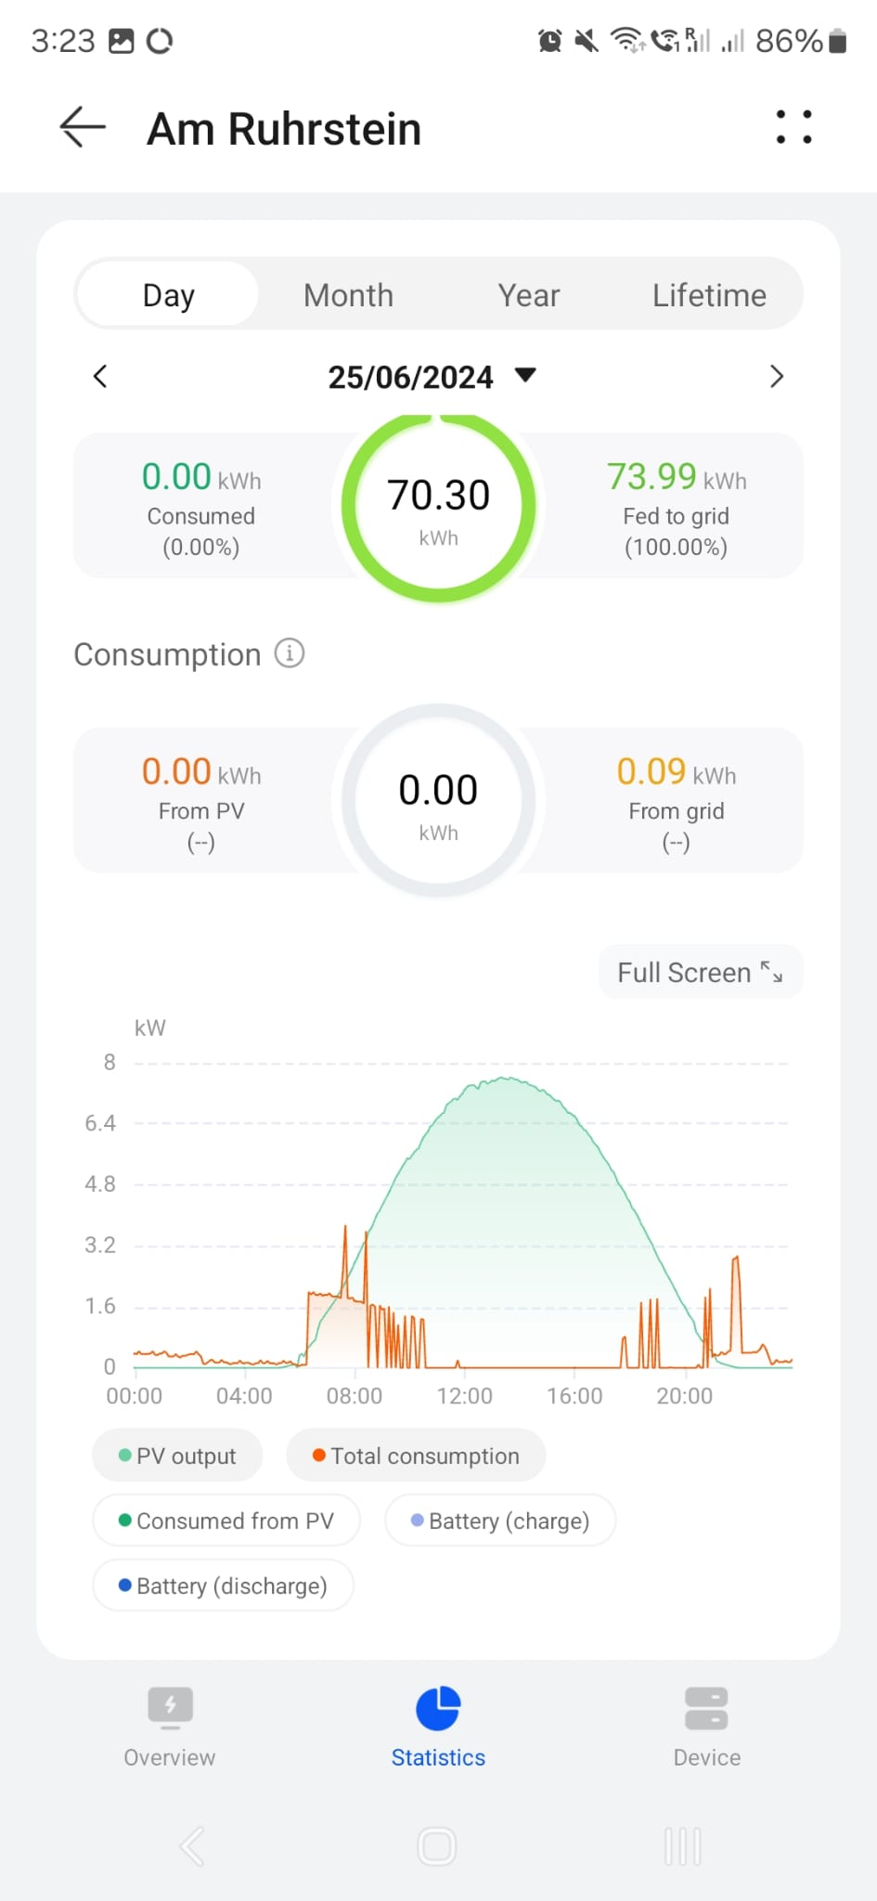
Demand
Digitalization
Notes:
Demand is real world data
Demand monitoring data digitalized and worst case assumed
i.e. maximum of both curves for every timestep

Slide 5
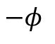
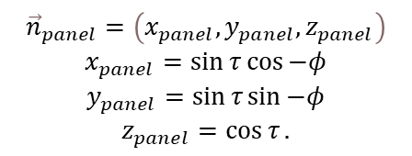
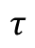
Panel Model
N
z
x
$$P_{panel}\left(φ,τ,t\right)=P_{max}⋅f_{θ}\left(φ, τ, t\right)⋅f_{a}\left(t\right)$$
$$−φ$$
W
y
x
$${\vec{n}}_{panel}=\left(x_{panel}, y_{panel}, z_{panel}\right)$$
$$x_{panel}=\sin{τ}\cos{−φ}$$
$$y_{panel}=\sin{τ}\sin{−φ}$$
$$z_{panel}=\cos{τ}.$$
$$τ$$
S
Notes:
Panel model basics
Angles
Power modeling with factors and pmax
Pmax = power at perpendicular insolidation laying flat
Factor for incidence angle
Factor for atmosphere transmittance
Panel normal needed for geometry

Slide 6
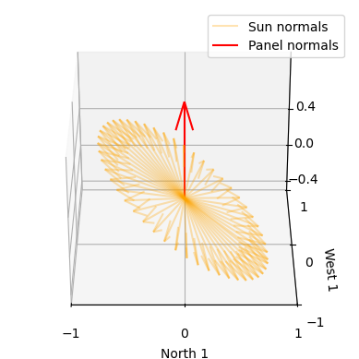
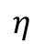

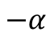
Sun Model
$$\begin{aligned}{\vec{n}}_{sun}=\left(x_{sun}, y_{sun}, z_{sun}\right) \\ \begin{aligned}x_{sun}=\sin\left(90°−η\right)\cos{−α} \\ \begin{aligned}y_{sun}=\sin\left(90°−η\right)\sin{−α} \\ z_{sun}=\cos\left(90°−η)\right.\end{aligned}\end{aligned}\end{aligned}$$
S
z
$$η$$
y
E
$$−α$$
W
N
x
Notes:
Sun model
Needed for both factors
Astropy powered

Slide 7
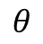
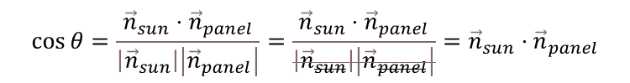

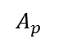
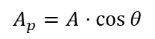
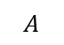
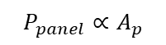
Panel Model – Angle of incidence
$$P_{panel}∝A_{p}$$
$$θ$$
$$A_{p}=A⋅\cos{θ}$$
$$f_{θ}=\frac{A_{p}}{A}=\cos{θ}$$
$$\cos{θ}=\frac{{\vec{n}}_{sun}⋅{\vec{n}}_{panel}}{\left|{\vec{n}}_{sun}\right|\left|{\vec{n}}_{panel}\right|}=\frac{{\vec{n}}_{sun}⋅{\vec{n}}_{panel}}{\left|{\vec{n}}_{sun}\right|\left|{\vec{n}}_{panel}\right|}={\vec{n}}_{sun}⋅{\vec{n}}_{panel}$$
$$A$$
$$f_{θ}\left(φ, τ, t\right)={\vec{n}}_{sun}\left(t\right)⋅{\vec{n}}_{panel}\left(φ, τ\right)$$
$$A_{p}$$
Notes:
Panel power proportional to projected area
Projected area: area sun rays see
Proportional area through 3D algebra

Slide 8
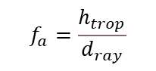
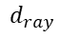
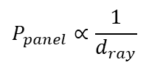

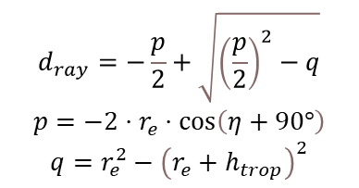
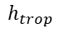
Panel Model – Atmosphere
$$P_{panel}∝\frac{1}{d_{ray}}$$
$$f_{a}=\frac{h_{trop}}{d_{ray}}$$
$$f_{a}\left(t\right)=\frac{h_{trop}}{d_{ray}\left(t\right)}$$
$${\left(r_{e}+h_{trop}\right)}^{2}=r_{e}^{2}+d_{ray}^{2}−2⋅d_{ray}⋅r_{e}⋅\cos\left(η+90°\right)$$
$$d_{ray}$$
$$d_{ray}=−\frac{p}{2}+\sqrt{{\left(\frac{p}{2}\right)}^{2}−q}$$
$$p=−2⋅r_{e}⋅\cos\left(η+90°\right)$$
$$q=r_{e}^{2}−{\left(r_{e}+h_{trop}\right)}^{2}$$
$$h_{trop}$$
$$η$$
$$r_{e}$$
Notes:
Panel power proportional to transmittance
Transmittance inversely proportional to travel distance
Geometry defines travel distance

Slide 9
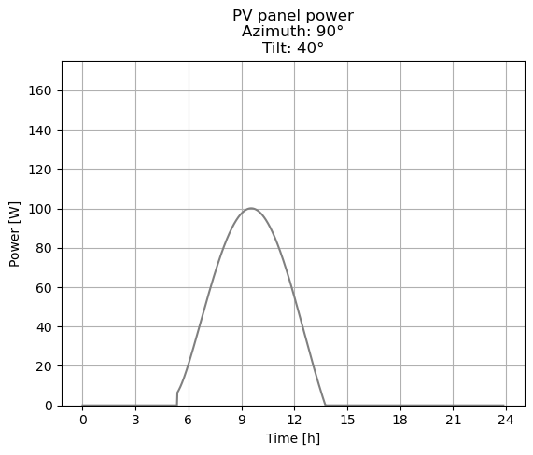
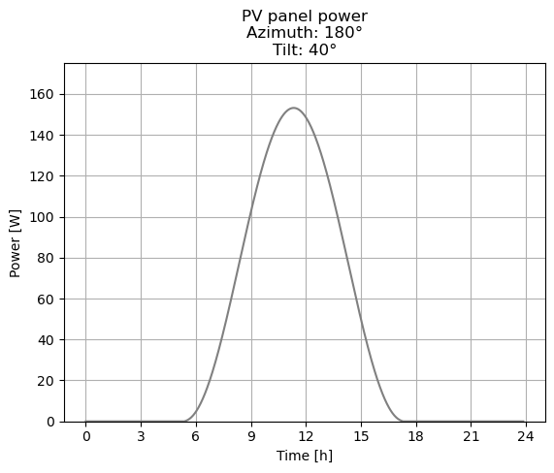
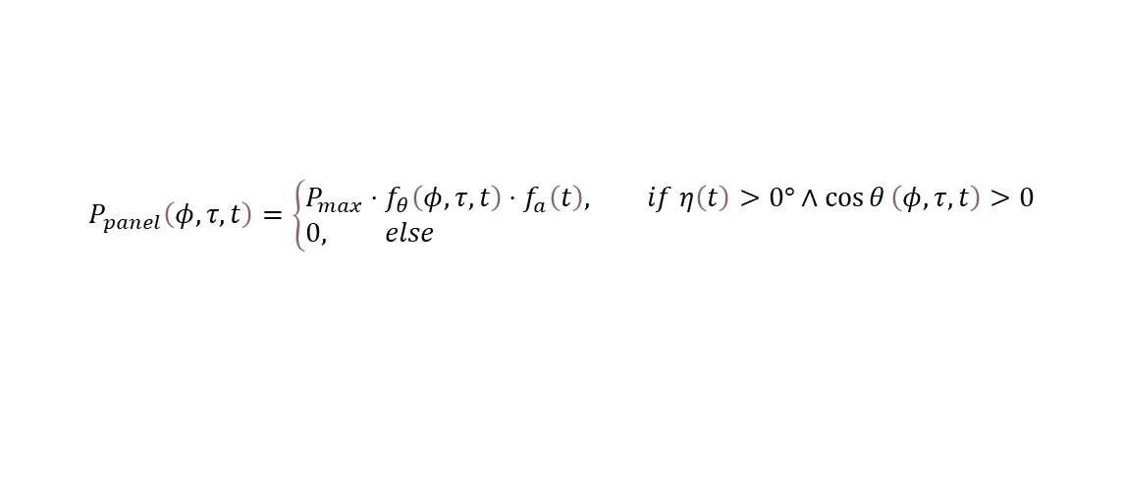
Panel Model – Consolidation
$$P_{panel}\left(φ, τ, t\right)=\left\{\begin{aligned}&P_{max}⋅f_{θ}\left(φ, τ, t\right)⋅f_{a}\left(t\right), if η\left(t\right)>0°∧\cos{θ}\left(φ,τ, t\right)>0 \\ &0, else\end{aligned}\right.$$
Notes:
Panel power extended with sensibility checks for
Sun above horizon
Sun in from
Panel characteristics show promising results

Slide 10
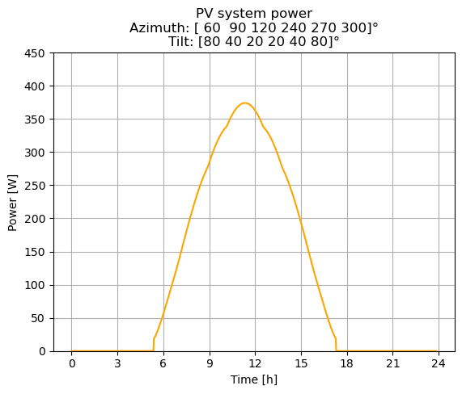
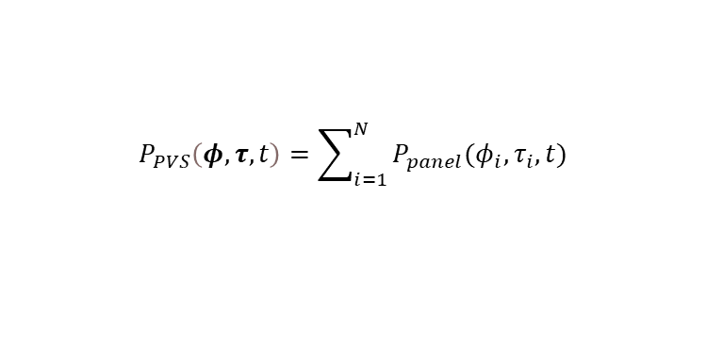
Photovoltaic system model
$$P_{PVS}\left(φ, τ, t\right)=\sum_{i=1}^{N}{P_{panel}(φ_{i}, τ_{i},t)}$$
Notes:
PVS is a set of panels with independant orientation

Slide 11
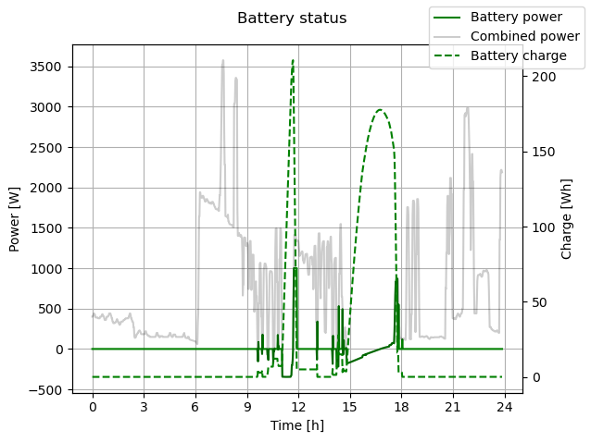
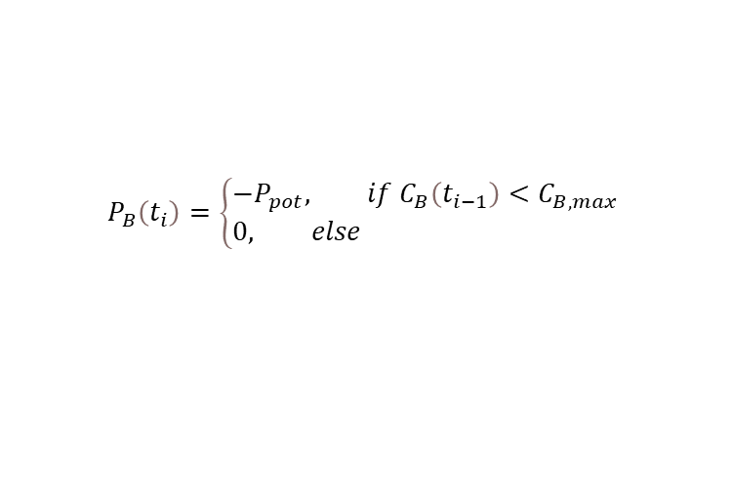
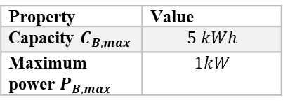
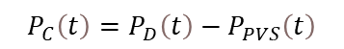
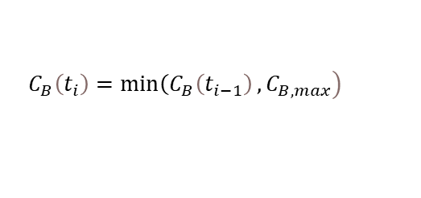

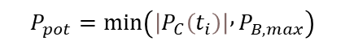
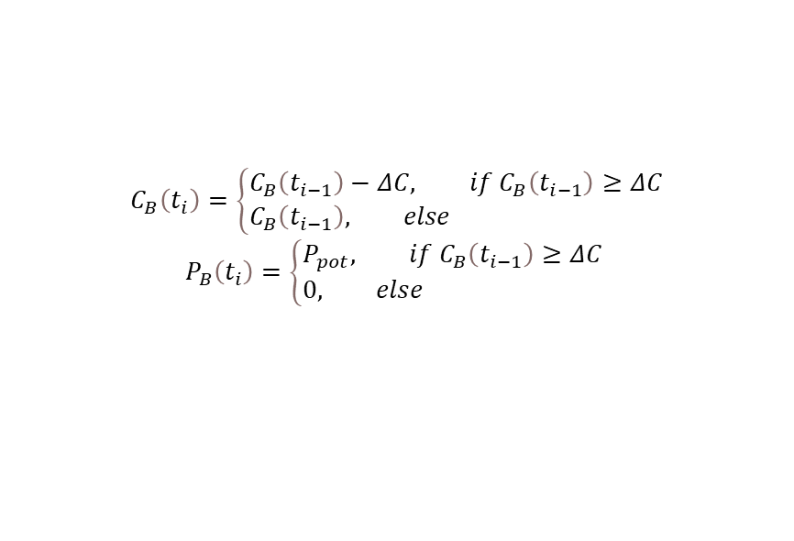
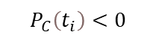
Battery Model
Property | Value
Capacity $C_{B,max}$ | $$5 kWh$$
Maximum power $P_{B,max}$ | $$1kW$$
$$P_{C}\left(t\right)=P_{D}\left(t\right)−P_{PVS}\left(t\right)$$
$$P_{pot}=\min\left(\left|P_{C}\left(t_{i}\right)\right| , P_{B,max}\right)$$
$$ΔC=P_{pot}⋅Δt$$
$$P_{C}\left(t_{i}\right)<0$$
$$\left.C_{B}\left(t_{i}\right)=\min\left(C_{B}\left(t_{i−1}\right)\right., C_{B,max}\right)$$
$$P_{B}\left(t_{i}\right)=\left\{\begin{aligned}&−P_{pot}, if C_{B}\left(t_{i−1}\right)<C_{B,max} \\ &0, else\end{aligned}\right.$$
$$P_{C}\left(t_{i}\right)>0$$
$$C_{B}\left(t_{i}\right)=\left\{\begin{aligned}&C_{B}\left(t_{i−1}\right)−ΔC, if C_{B}\left(t_{i−1}\right)≥ΔC \\ &C_{B}\left(t_{i−1}\right), else\end{aligned}\right.$$
$$P_{B}\left(t_{i}\right)=\left\{\begin{aligned}&P_{pot}, if C_{B}\left(t_{i−1}\right)≥ΔC \\ &0, else\end{aligned}\right.$$
Notes:
Battery model
Negative power: battery charging
Positive power: battery draining
Case dependant (thus very computationally expensive)
If power less than 0
Battery charging when not full
If power greater than 0
Battery draining when not empty

Slide 12
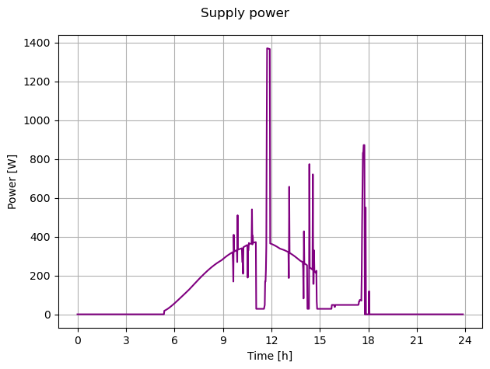
Supply system model
$$P_{S}\left(φ, τ, t\right)=P_{PVS}\left(φ, τ, t\right)+P_{B}\left(t\right)$$
Notes:
Supply system as combination of PVS power and battery power
This is what the system provides into the house
Always greater than or equal to 0 except demand would be negative

Slide 13
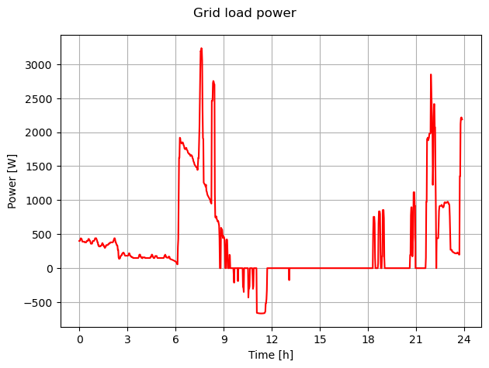
Grid load model
$$P_{G}\left(φ, τ, t\right)=P_{D}\left(t\right)−P_{S}\left(φ , , τ t\right)$$
Notes:
This is what the grid sees as load
Negative values mean power is sold to grid

Slide 14
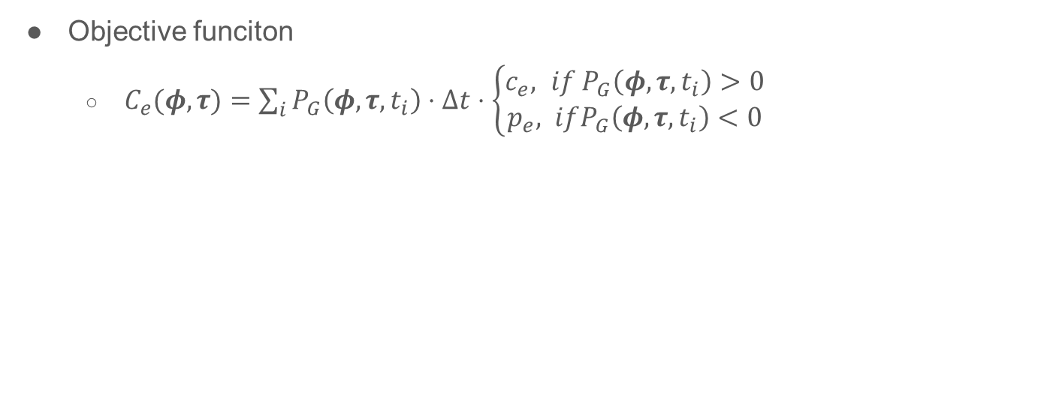
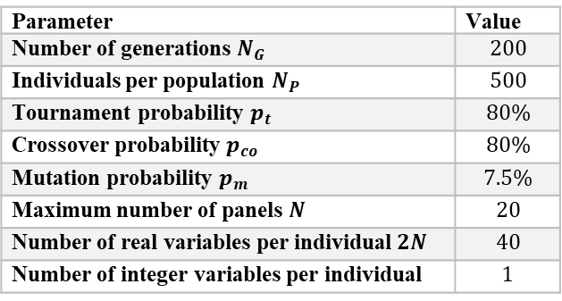
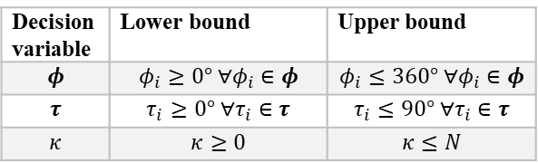
Optimization
Objective funciton
$C_{e}(φ, τ)=\sum_{i}{P_{G}\left(φ, τ, t_{i}\right)⋅Δt⋅\left\{\begin{aligned}c_{e}, if P_{G}\left(φ, τ, t_{i}\right)>0 \\ p_{e}, ifP_{G}\left(φ, τ, t_{i}\right)<0\end{aligned}\right.}$
Parameter | Value
Number of generations $N_{G}$ | $$200$$
Individuals per population $N_{P}$ | $$500$$
Tournament probability $p_{t}$ | $$80\%$$
Crossover probability $p_{co}$ | $$80\%$$
Mutation probability $p_{m}$ | $$7.5\%$$
Maximum number of panels $N$ | $$20$$
Number of real variables per individual $2N$ | $$40$$
Number of integer variables per individual | $$1$$
Decision variable | Lower bound | Upper bound
$$φ$$ | $$φ_{i}≥0° ∀φ_{i}∈φ$$ | $$φ_{i}≤360° ∀φ_{i}∈φ$$
$$τ$$ | $$τ_{i}≥0° ∀τ_{i}∈τ$$ | $$τ_{i}≤90° ∀τ_{i}∈τ$$
$$κ$$ | $$κ≥0$$ | $$κ≤N$$
Notes:
Objective function: cost of electricity per day
Feed in tariff and cost for grid of location
Decision variables: Orientations of panels defined by
Azimuth
Tilt
Number of panels to use
Genetic algroithm used because of non linearity and both real and integer variables
Parameters
Number of maximum panels driven by location of pv system

Slide 15
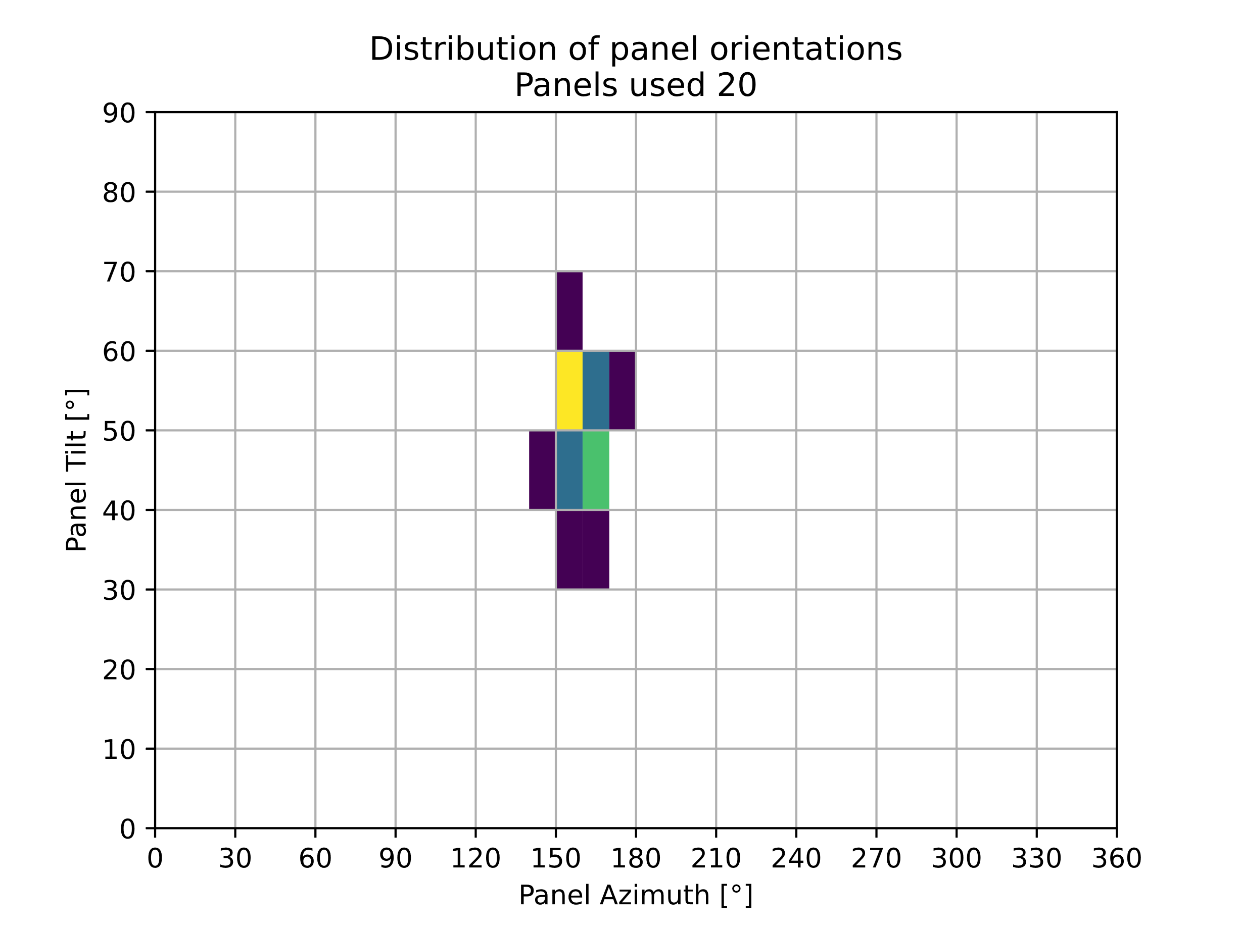
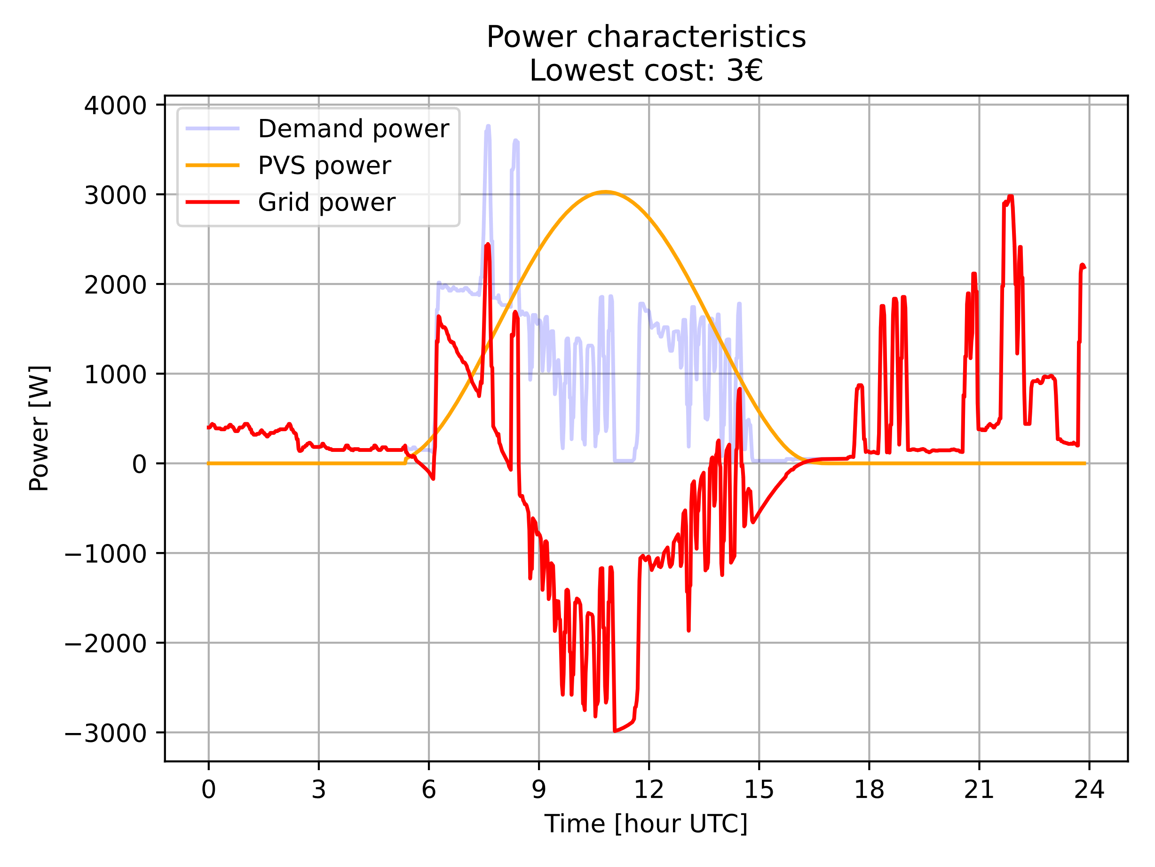
Results – System w/o battery Statistical runs
Notes:
100 runs
Very concentrated orientation of panels
No power matching slight shift to higher demands in morning
Reason: Deviaiton in negative direction is not penalized but rewarded
All panels used

Slide 16
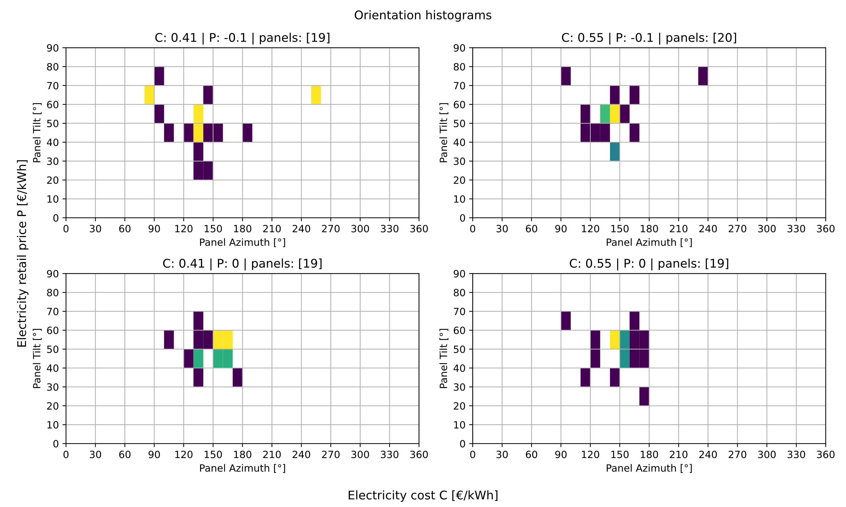
Results – System w/o battery Different costs
Notes:
Future scenario: Costs increase and feed in tariff decreases (already happening in Germany)
Orientations show more spread
Upper left shows orientations towards east and west matching power demands
Could also be variance in optimization result.
No multiple runs possible for this as very computationally expensive

Slide 17
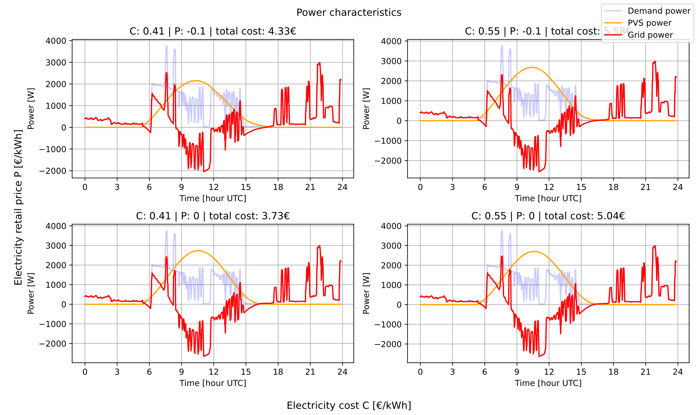
Results – System w/o battery Different costs
Notes:
Less panels used equal less peak power.
Sight power matching for top right

Slide 18
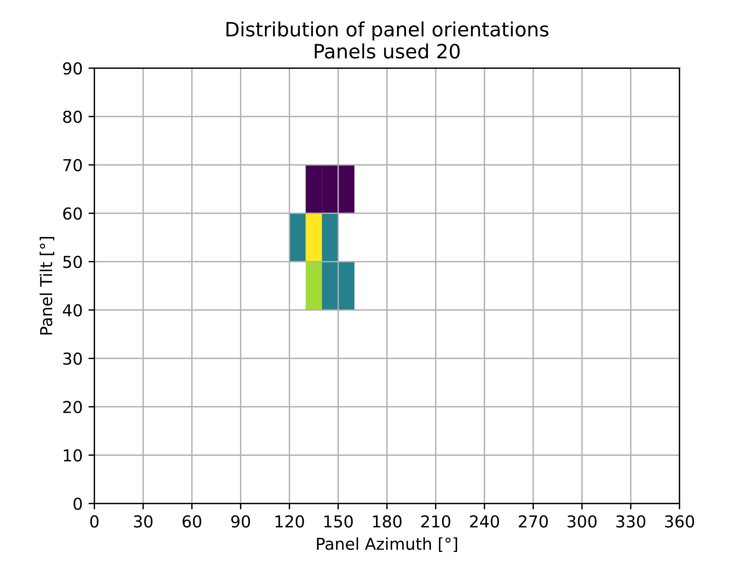

Results – System with battery Statistical runs
Notes:
Orientation in very narrow range
shifted to east
Stategy:
Generate as much power in the morning while covering demand best
Use charge to supply evening demand
All panels used

Slide 19

Results – System with battery Different costs
Notes:
Spread greater
Less panels are used in some cases
Spread increase less intense than for no battery system.
Not only variance due to algorithm

Slide 20

Results – System with battery Different costs
Notes:
Almost no pattern matching visible.
Strategy unchanged to single case run
Makes sense: this system is more robust against price changes
Edge case would be independant system

Slide 21
Conclusion
Marginal supply-demand matching
Sensitive to feed-in tariffs
Battery system less sensitive
Outlook:
Larger timespan
Optimize battery
Tipping point for prices
Net present value analysis
More generations
Notes:
Supply demand matching as expected (close match) did not occur
Sensitive to tariffs
Battery system more independant
Further options
Larger timespan
What about summer?
Battery optimization
Tipping point for prices
NPV analysis
More generations

